Slide 1

Online Geeks
Instagram IP Address Finder
W W W . O N L I N E G E E K S . N E T / I N S T A G R A M - I P - A D D R E S S - F I N D E R
INTERNET

Slide 2

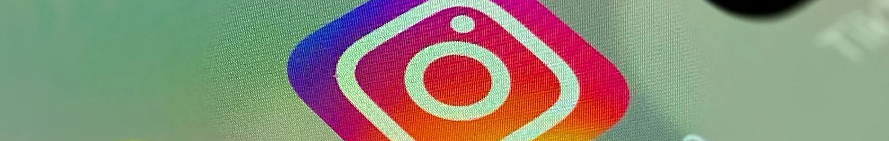
Content
Online Geeks
01
INTRODUCTION
05
CONTACT US
02
WHY YOU SHOULD FIND SOMEONE'S IP ADDRESS ON INSTAGRAM
06
THANKYOU
03
HOW TO FIND SOMEONE'S IP ADDRESS
04
BEST INSTAGRAM IP ADDRESS FINDER WEBSITE

Slide 3
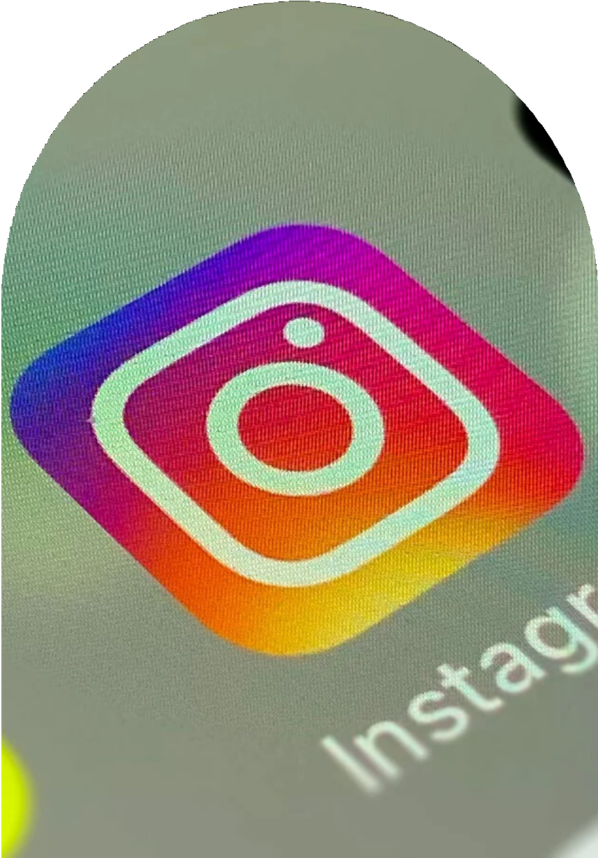
Introduction
Instagram is a fastest growing social media platform where you can interact with your friends. When you get connected to the social world, your identity is exposed online. You know anyone an find your IP address in a minutes from Instagram.
Basically, an IP address is used to identify the particular computer or smartphone attached to the network. Specifically, it's used to track someone's identity or location.

Slide 4

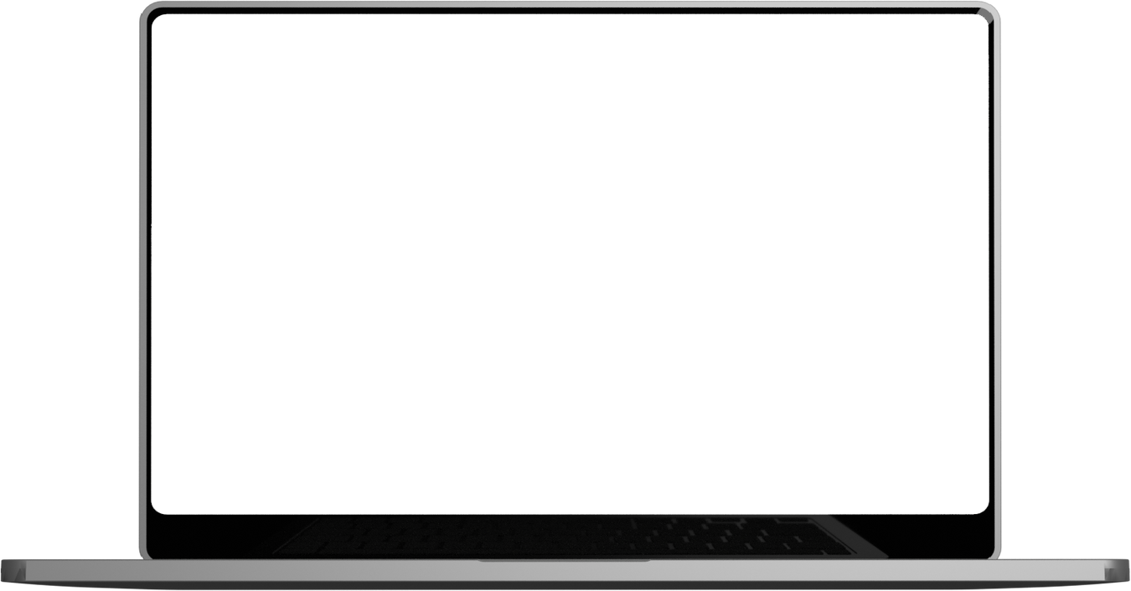

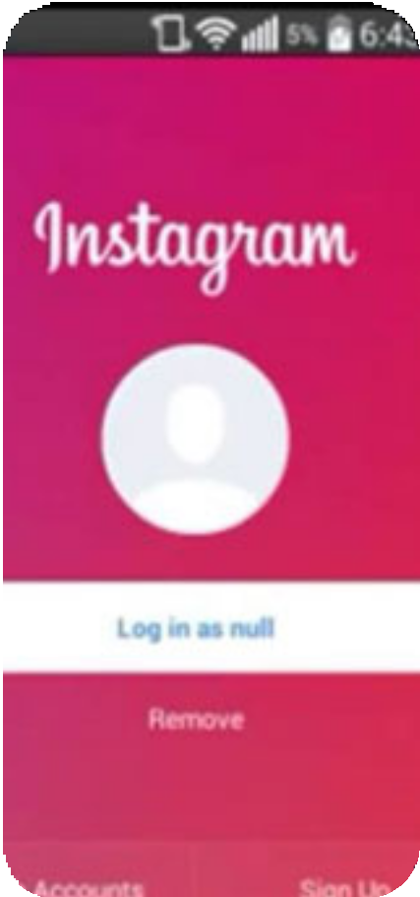
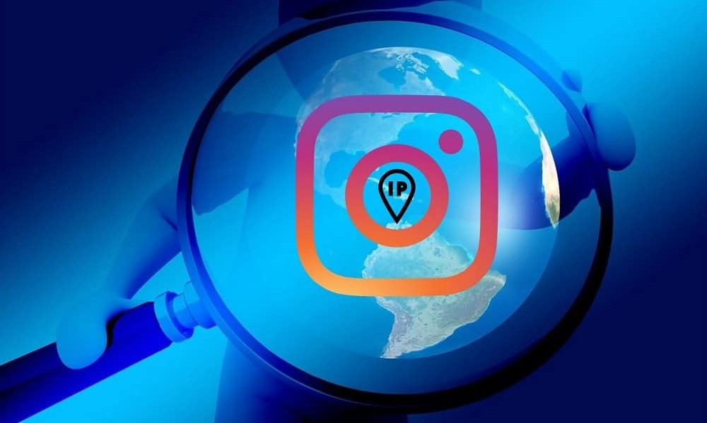
Online Geeks
Why you should find someone's IP address on instagram
Supposed somebody has opened a fake Instagram account that is being used to harass you or blackmailed you then the only way is to track them by their IP address.
If you want to find any fraudulent activity or any suspicious log in attempt on your Instagram account. then IP tracking is neccessary.

Slide 5
Online Geeks
There are many website on google that tell you that they can help you to find someone's IP address on Instagram. In fact, some website gives you the box where you locate IP in real time. We have one of the best tools among them "Instagram IP Address Finder"
How to Find Someone'S IP address

Slide 6
Best Instagram IP Address Finder Website
5
Spokeo
4
3
Social Catfish
2
Been Verified
1
iStaunch
Grabify IP Logger

Slide 7
Visit Our Website:
www.onlinegeeks.net/instagram-ip-address-finder

Slide 8
THANK YOU

